Slide 1

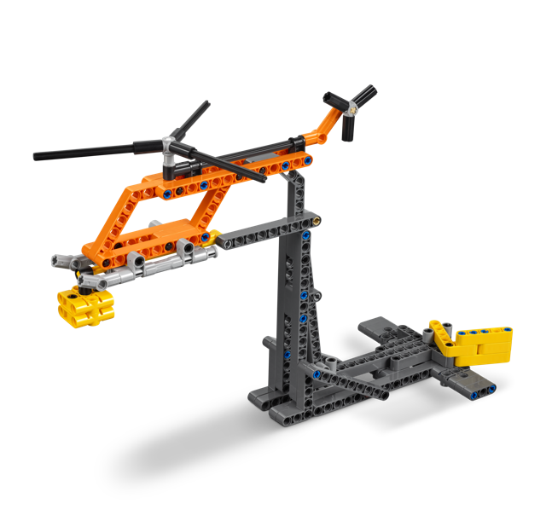
Session 5
Notes:
Review pages 16-17 in the Team Meeting Guide before starting session 5.
Checkpoint 1
The team has bonded and are working well together. If they need more support to achieve this, do some extra team-building activities.
New teams may want to summarize the new robot skills they have learned.
All models must be built and placed on the mat, secured with the Dual Lock™ as needed.
Extra time can be spent on the robot lessons before moving on.
The team has explored and designed solutions for all the Project Sparks.
The team has reviewed the missions and rules in the Robot Game Rulebook.

Slide 2

Session Overview
Outcomes
The team will apply coding principles to the guided mission.
The team will research solutions and identify their Innovation Project problem to solve.
Notes:
Facilitator Tips for Session 5-8
Core Values: Remember the Core Values are about HOW the team behaves and works together. They should be demonstrated by all the team, all the time.
Innovation Project: Teams will have to select a final problem and solution to focus on, so thinking about this goal during each session is helpful.
Robot Design: At the event, two mats will be set up next to each other. However, during the sessions, you will probably work with a single mat.
Robot Game: The team could look for missions that use basic robot skills like:
Push, pull, or lift
Models close to home
Navigation with line following
Easy access to return home
Facilitator Tips for Session 5
Team-building activities are great way for teams to develop and use their Core Values and learn how to work together. Search online for great activities developed by the FIRST® community.

Slide 3
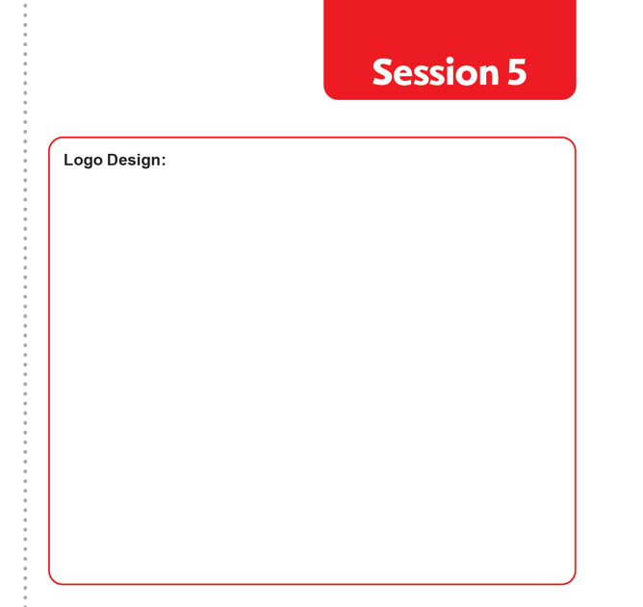

Introduction
Now that you have been working together as a team, create a team name!
Design a poster of your team name as a logo.
Be sure each person gets to contribute to the poster!
Notes:
Facilitator Tips
Provide supplies to create posters with their team names as logos.

Slide 4


Guided Mission
Open the SPIKE™ Prime or EV3 Classroom app. Find your lesson.
Read over the guided mission.
Have fun practicing this guided mission until it works perfectly!
Notes:
Facilitator Tips
If the team is sharing one robot, they can code on individual devices then take turns running their programs onto the robot.
The provided code for the guided mission will not only solve the Air Drop mission but also be helpful to use on other missions.
Show the Guided Mission portion of the season video again.
If an attachment is needed for a mission, keep it in a plastic bag labeled with the mission number.

Slide 5
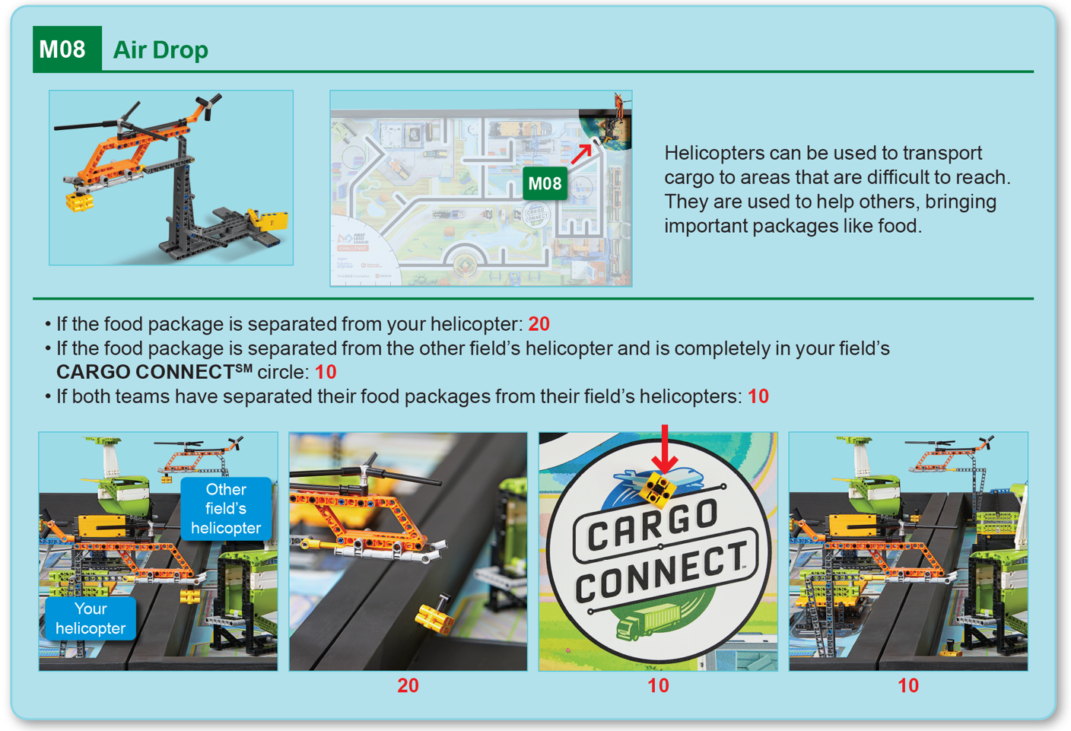

Robot
Game
Rulebook
page 16

Slide 6
Guided Mission
Helicopters can be used to transport cargo to areas that are difficult to reach. They are used to help others, bringing important packages like food.
Like all the mission models on the FIRST® LEGO® League Challenge competition field, the Air Drop in Mission 8 (M08) might inspire you to think of a solution for your Innovation Project.
To help you learn about using the color sensor to follow lines on the mat, we have created a guided mission lesson.

Slide 7
Guided Mission
In the app, you will:
Download the program that solves this mission.
Start your robot in the right position in the launch area.
Run your robot and watch it complete the mission and score the points.
Think about how to incorporate the Air Drop mission into one of your runs for the Robot Game.
Continue to practice your new skills by revisiting previous lessons or moving onto the Advanced Driving Base lesson.

Slide 8

Guided Mission
Reflection Questions
What does the guided mission show you about Coopertition®?
How do you plan to talk with the other team at the Robot Game about the guided mission?

Slide 9
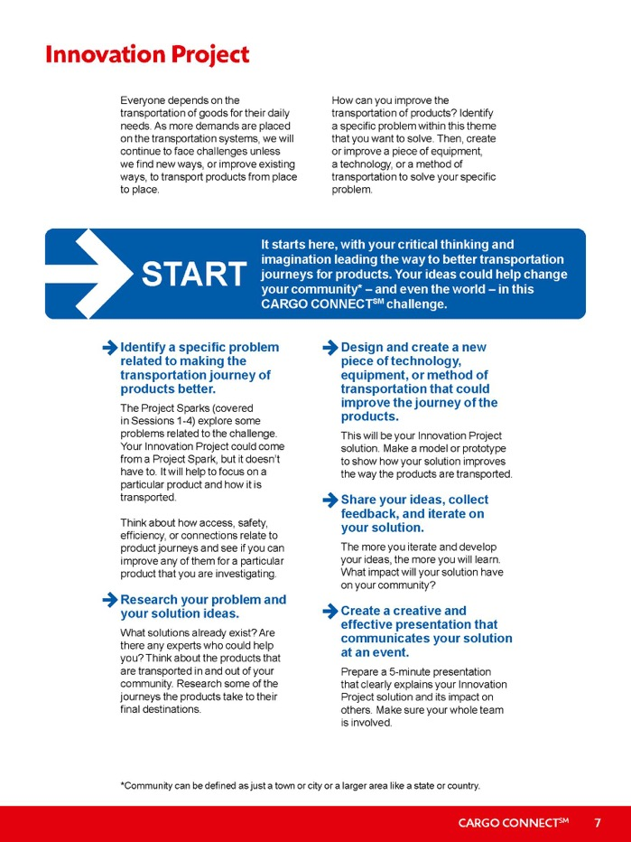
Investigations
Revisit page 7 and review the Project Sparks.
Think about the great solutions you have come up with in the previous sessions.
Notes:
Facilitator Tips
Encourage the team to record all problem ideas they have identified for the Innovation Project.

Slide 10
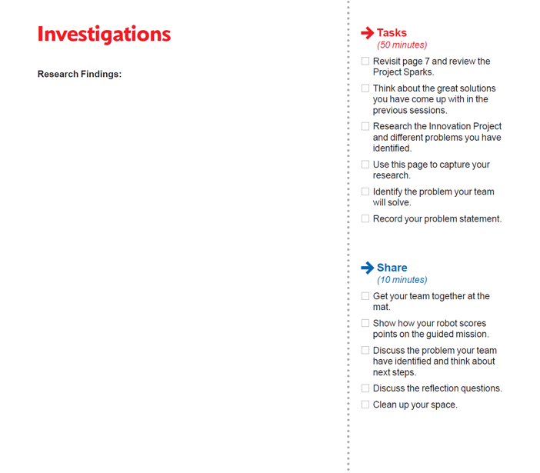
Investigations
Research the Innovation Project and different problems you have identified.
Use this page to capture your research.
Notes:
Facilitator Tips
Project resource examples include the Internet, books, magazines, personal stories, and experts (in person or virtual).

Slide 11

Investigations
Identify the problem your team will solve.
Record your problem statement.
Notes:
Facilitator Tips
Each team member might not get their favorite problem chosen, but the team should choose something everyone supports.
The team can use a problem identified within one of the Project Sparks to develop their solution.
The team will write their final problem statement here. If they have multiple ideas, use a voting process to narrow it down to one.

Slide 12
Share
Get your team together at the mat.
Show how your robot scores points on the guided mission.
Discuss the problem your team have identified and think about next steps.
Discuss the reflection questions.
Clean up your space.

Slide 13

Reflection Questions
Which transportation problem can you explain clearly?
Is there someone you can talk to that is an expert on the problem?

Slide 14
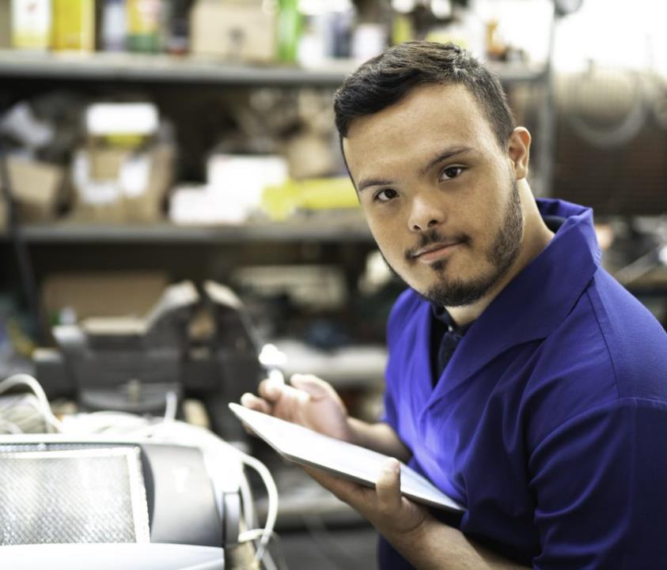
Career Connections
Machine Operator
Role:
Monitors and maintains warehouse sorting machines.

Slide 15

Multimedia Resources
You may wish to embed a relevant, age-appropriate video for your students here. See the Notes for an example.
Notes:
Choose a relevant, age-appropriate video for your students.
Here are two examples:
WFP’s Innovative Supply Chain Solutions from the United Nations World Food Programme – Length 5:36
https://youtu.be/18l7KPS79js
WFP Air Drop – Length 1:00
https://youtu.be/XKFML6ENOwI

Slide 16

Clean Up
Notes:
Allow time for cleanup and place any unfinished models and their pieces in a sealed plastic bag.

Slide 17

FIRST® and the FIRST® logo are registered trademarks of For Inspiration and Recognition of Science and Technology (FIRST). LEGO® and MINDSTORMS® are registered trademarks of the LEGO Group. FIRST® LEGO® League and CARGO CONNECTSM are jointly held trademarks of FIRST and the LEGO Group. SPIKE™ Prime is a trademark of LEGO® Education. All other trademarks are the property of their respective owners. ©2021 FIRST and the LEGO Group. All rights reserved.

